Slide 1
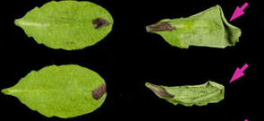
Protocol for syringe infiltration of P. syringae
1. For each bacterial strain, select four fully developed leaves of
each plant.
2. Mark the petioles with permanent ink for identification.
3. Using a 1-mL needleless syringe filled with bacterial suspension (OD 600 = 0.2 or 1 × 10 7 colony-forming units (CFU)/mL), gently infiltrate marked leaves on the abaxial surface.
4. Allow leaves to dry [we will use absorbing paper to gently wipe the left-over liquid on the leaf surface] and cover plants with a plastic wrap or a plastic dome to maintain high humidity.
5. Return plants to previous growth conditions for approximately
24 hours while HR cell death progresses.
No HR HR

Slide 2
Write down the number of leaves showing HR out of the number of leaves infiltrated
 | Strain infiltrated
Plant genotype |  | A | B | C
 | a | / | / | /
 | b | / | / | /
 | c | / | / | /

Slide 3
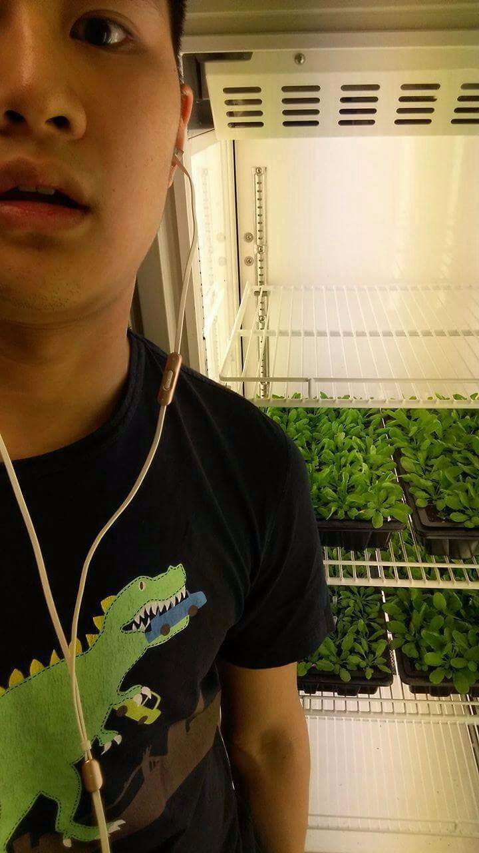
Discussion
Are there any unexpected HR?
Has HR appeared when it is not supposed to?
Are there any other methods to assess HR? (later)
ALL MY PLANTS DIED

Slide 4
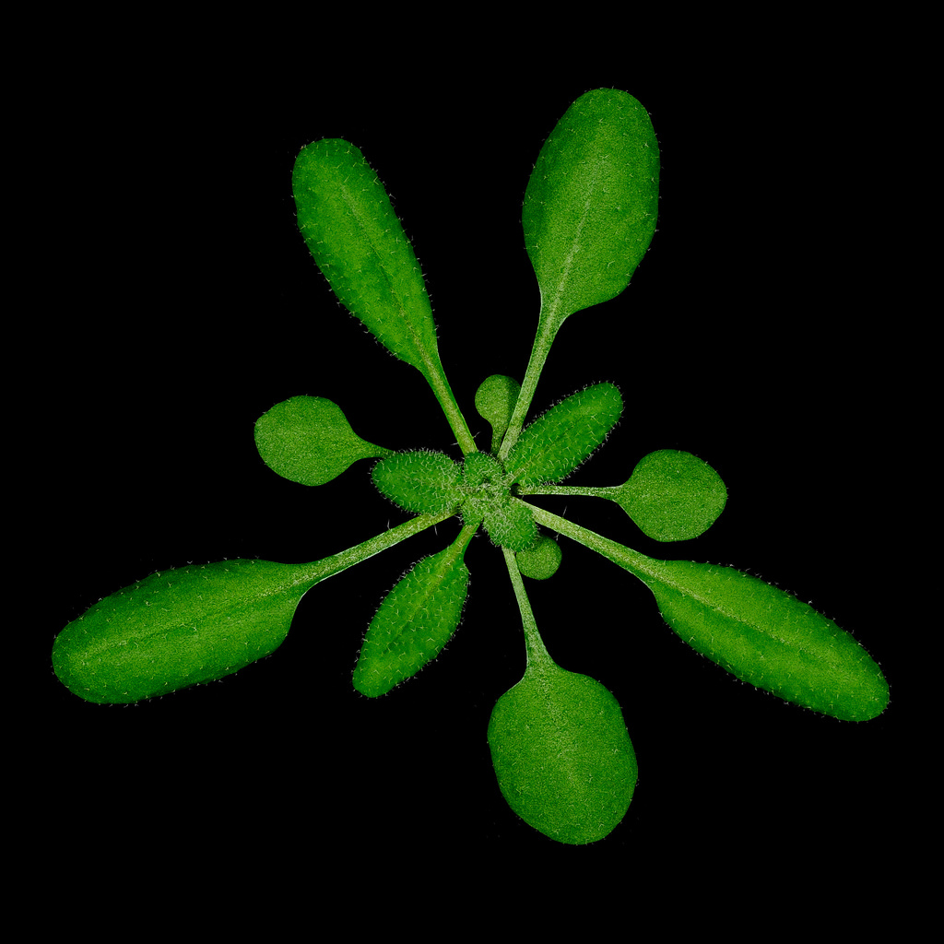
HR can be condition-dependent
Growing condition: 21–23 °C; 10 h light/14 h dark; 75% humidity
Leaf position
Age: plants of 5-week-old
Handling
Time of the day

Slide 5
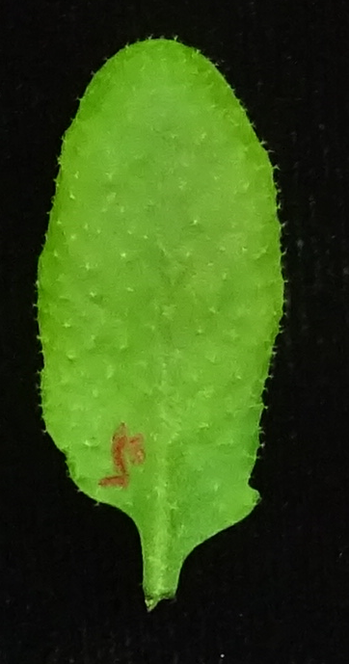
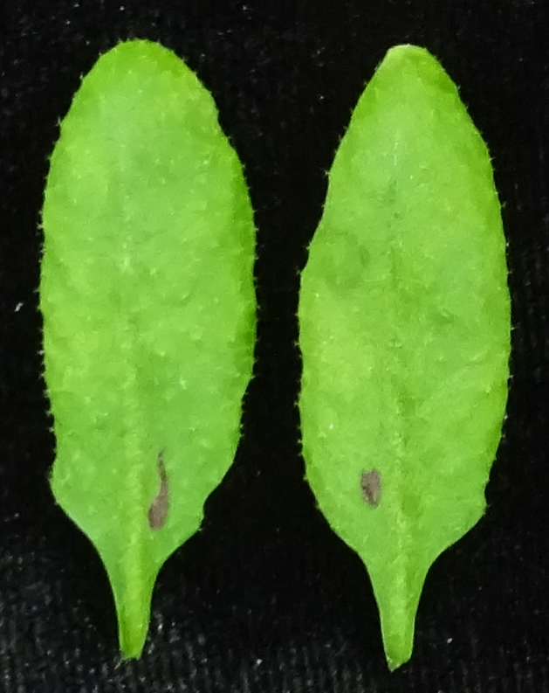
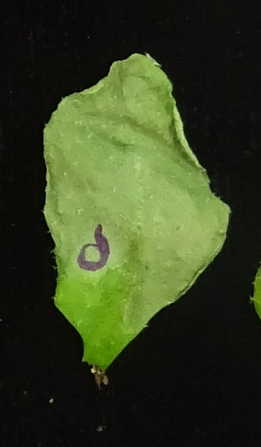
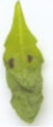
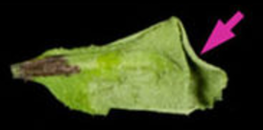
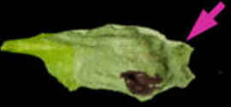
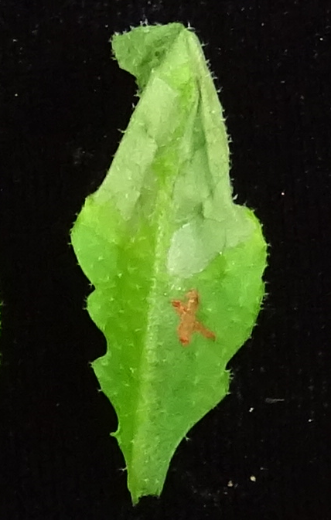
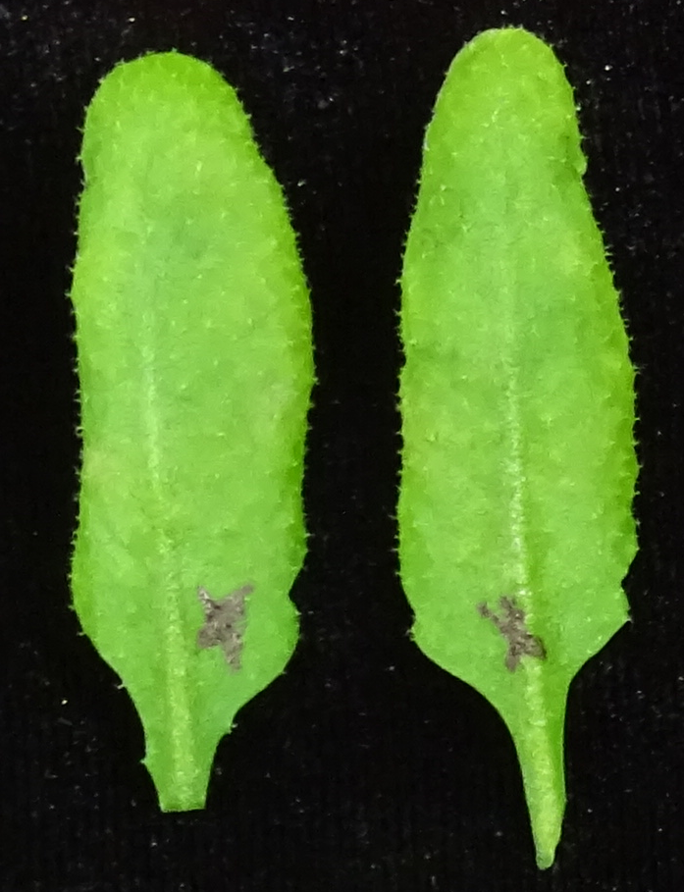
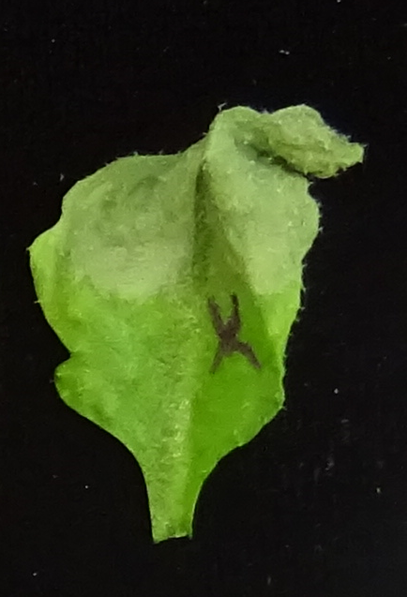
 | AvrRPS4 (A) | PopP2 (B) | AvrRPT2 (C)
a: rps4-21 /rps4b-1 (Col-0)
b: Ws-2
c: Col-0

Slide 6
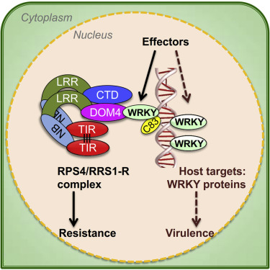
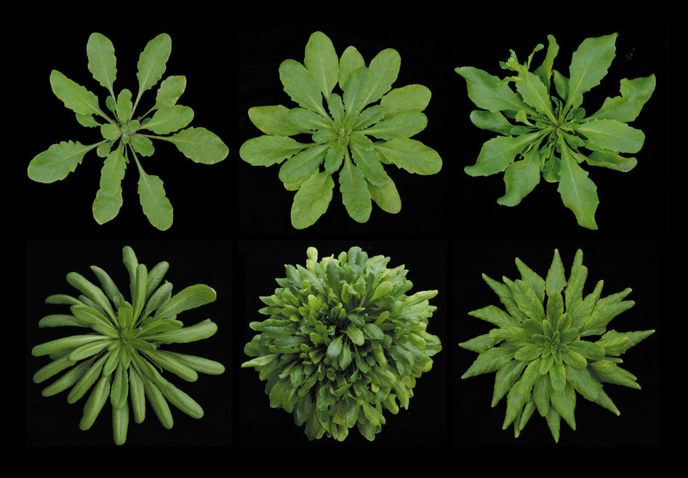
Arabidopsis ecotype - Col-0 & Ws-2
Ws-2: RRS1-R allele (longer version) - recognise PopP2
Col-0: RRS1-S allele – does not recognise PopP2

Slide 7
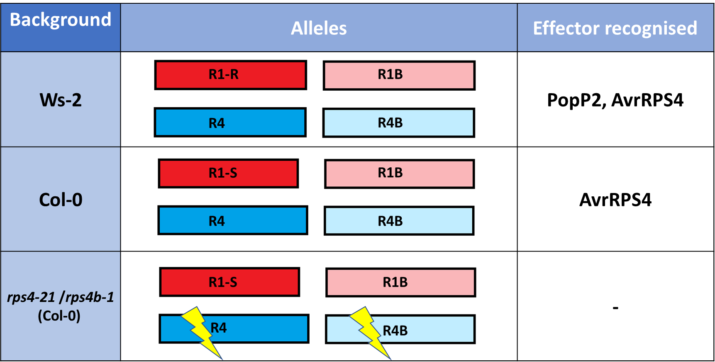

Background | Allele | Effector recognised
Ws-2 & Col-0 |  | AvrRPT2
RPS2

Slide 8
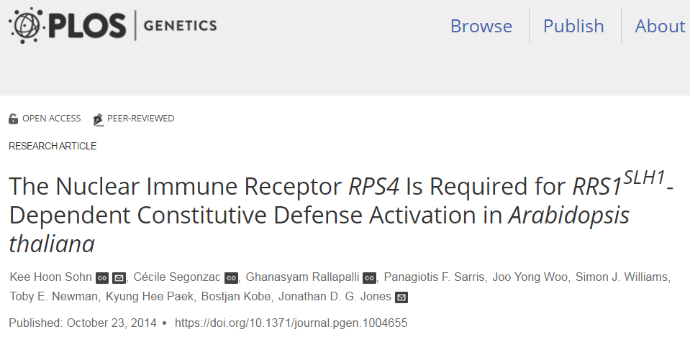
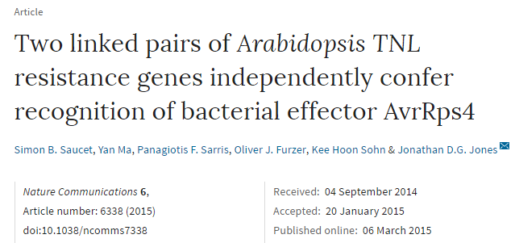
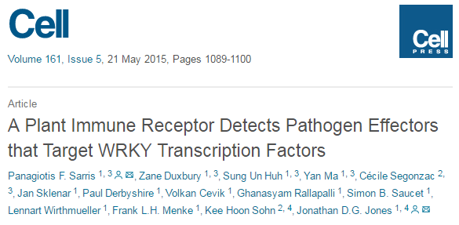
Some reference to follow on:

Slide 9
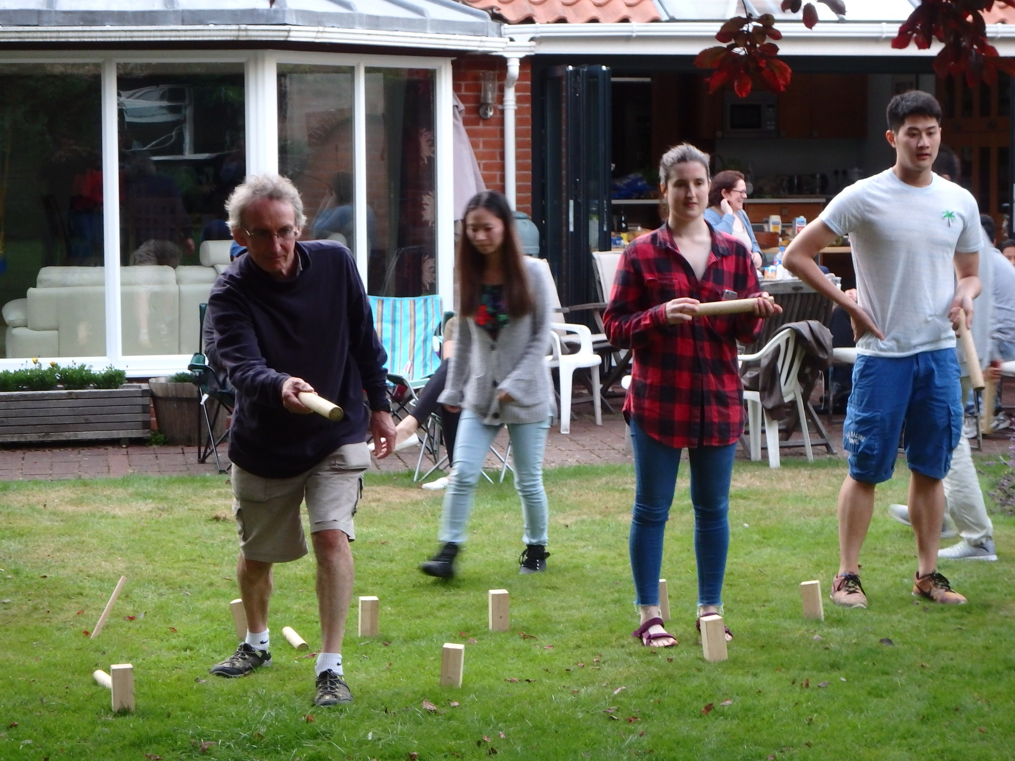
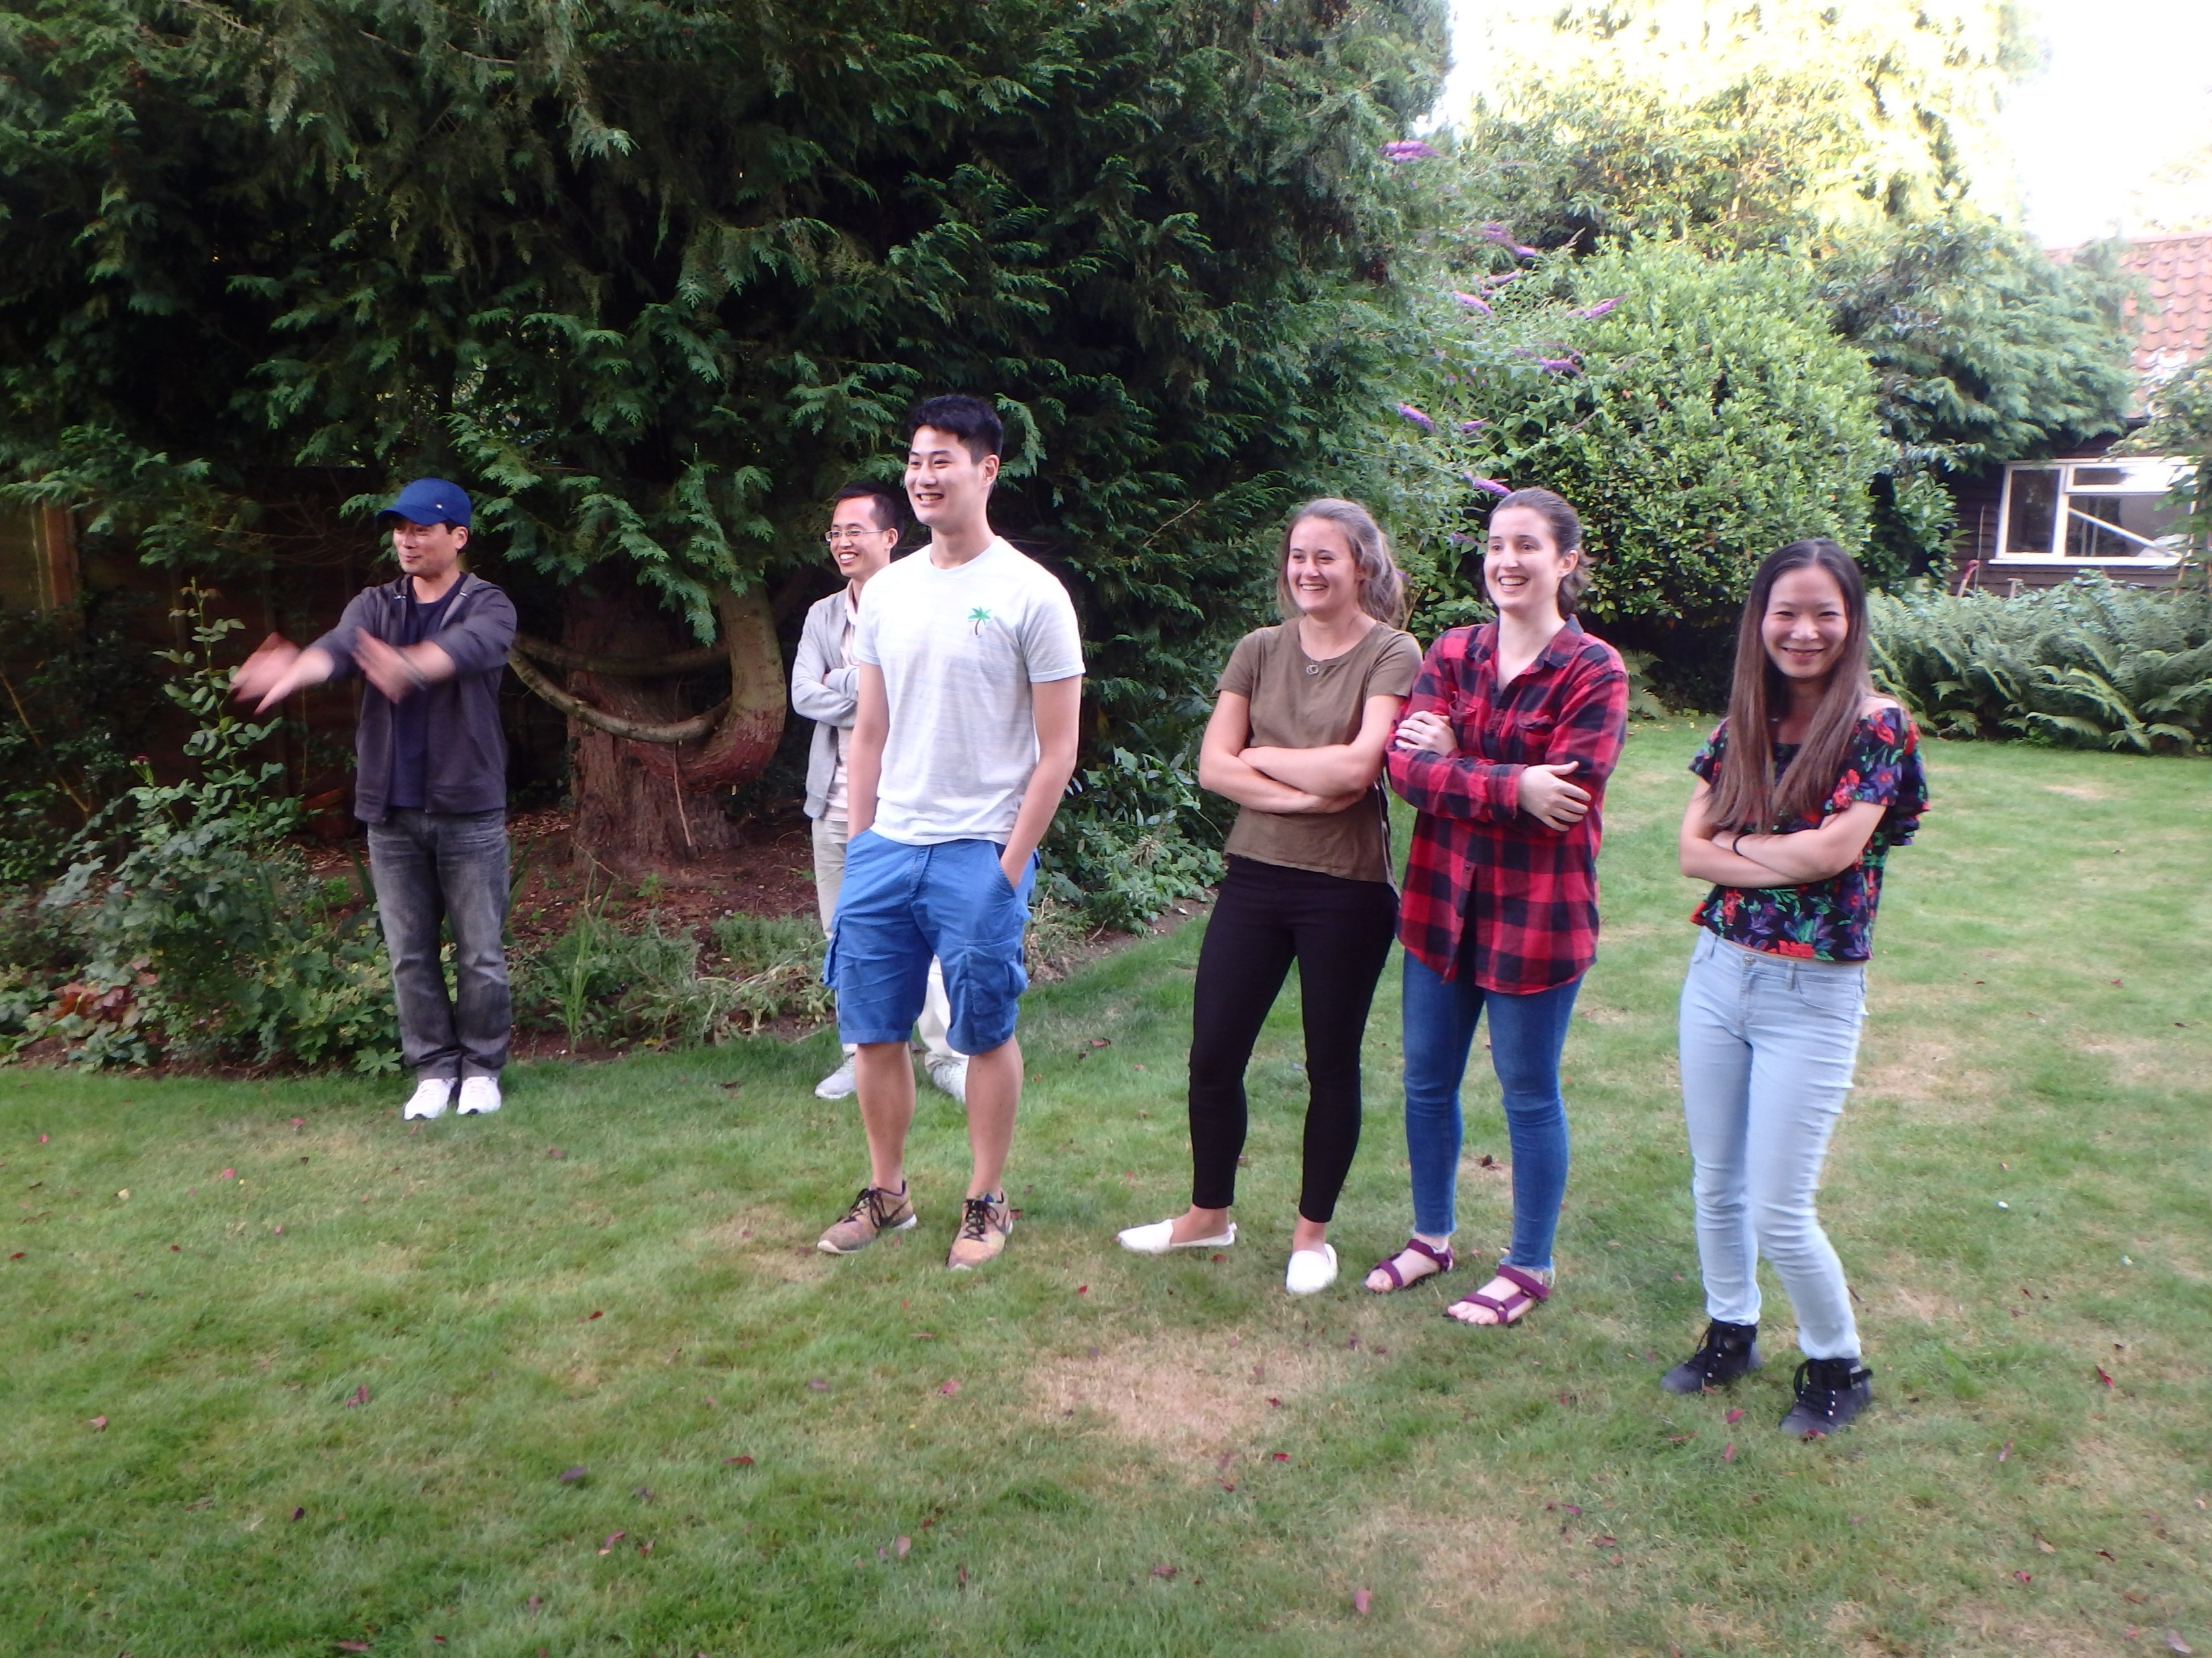

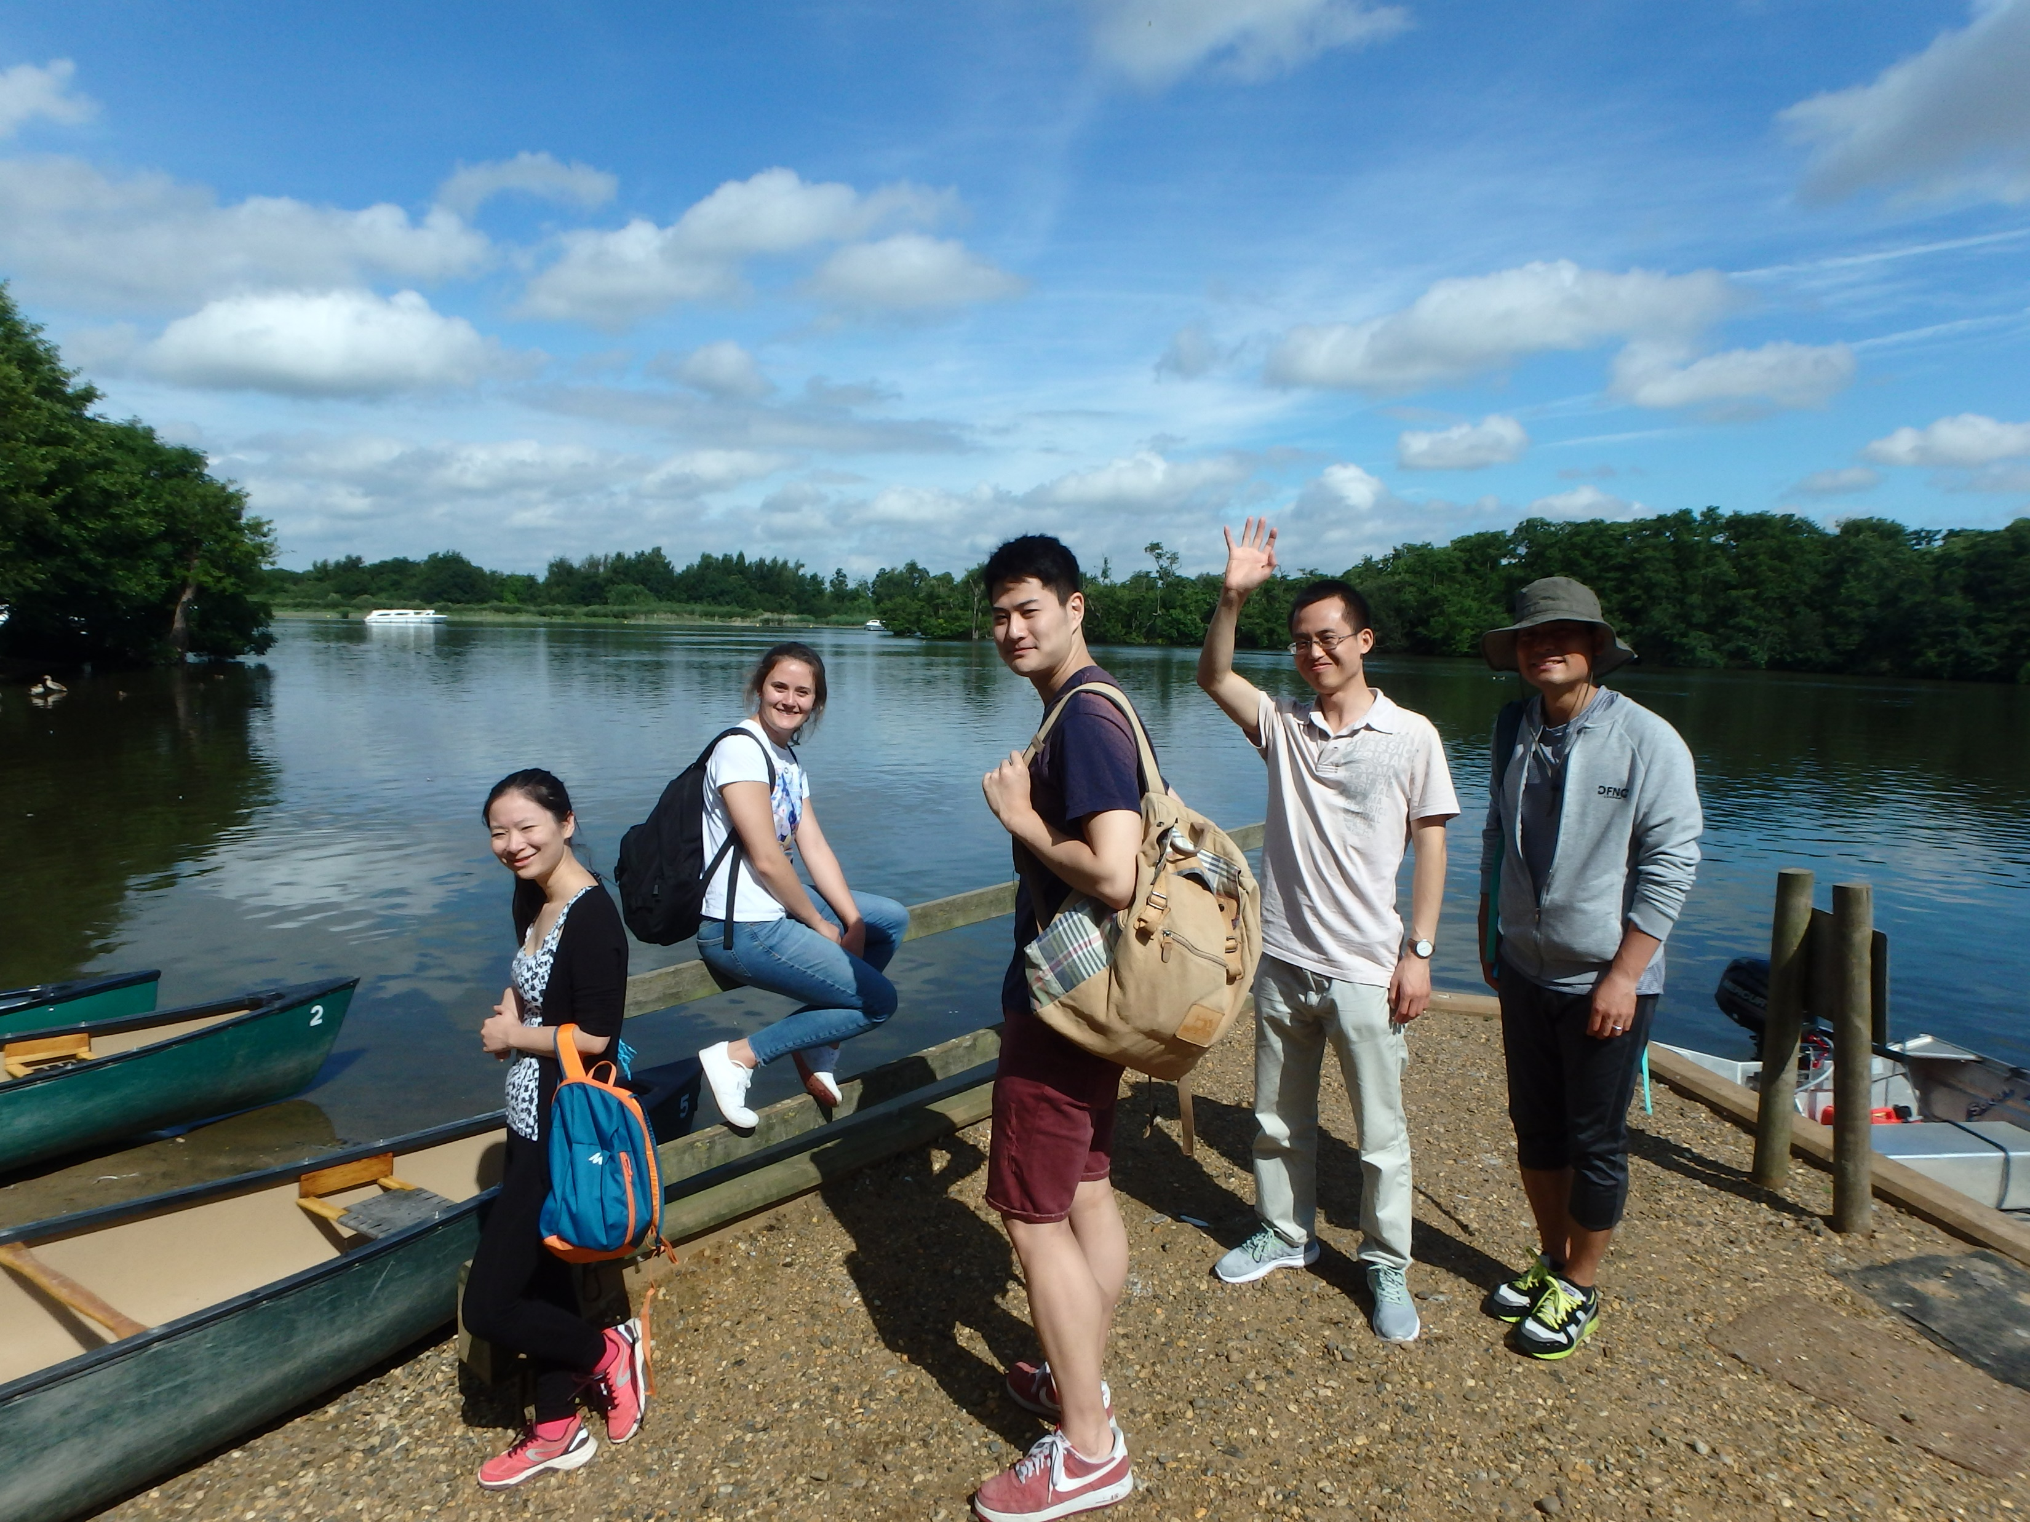
Acknowledgement
Jonathan Jones
R1/R4 group
Pingtao Ding
Zane Duxbury
Yan Ma
Hailong Guo
Hannah Brown
Joanna Feehan
Maximiliano Jimenez-Dalmaroni
Lanxi Hu
Panagiotis Moscou
Sung Un Huh

Slide 11
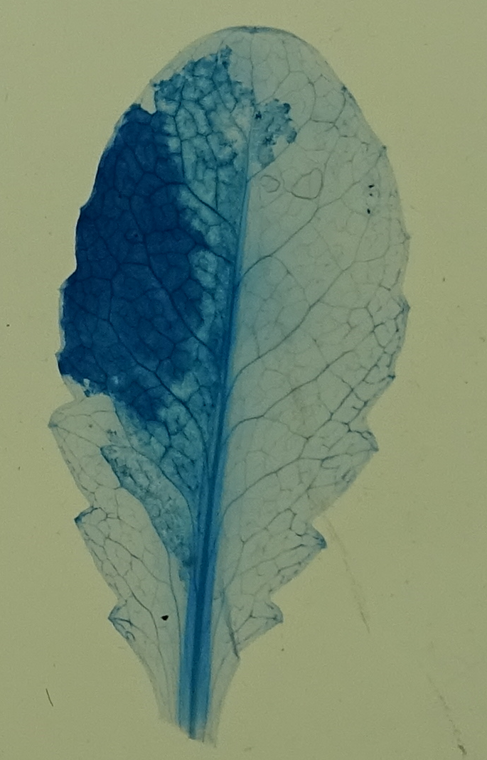
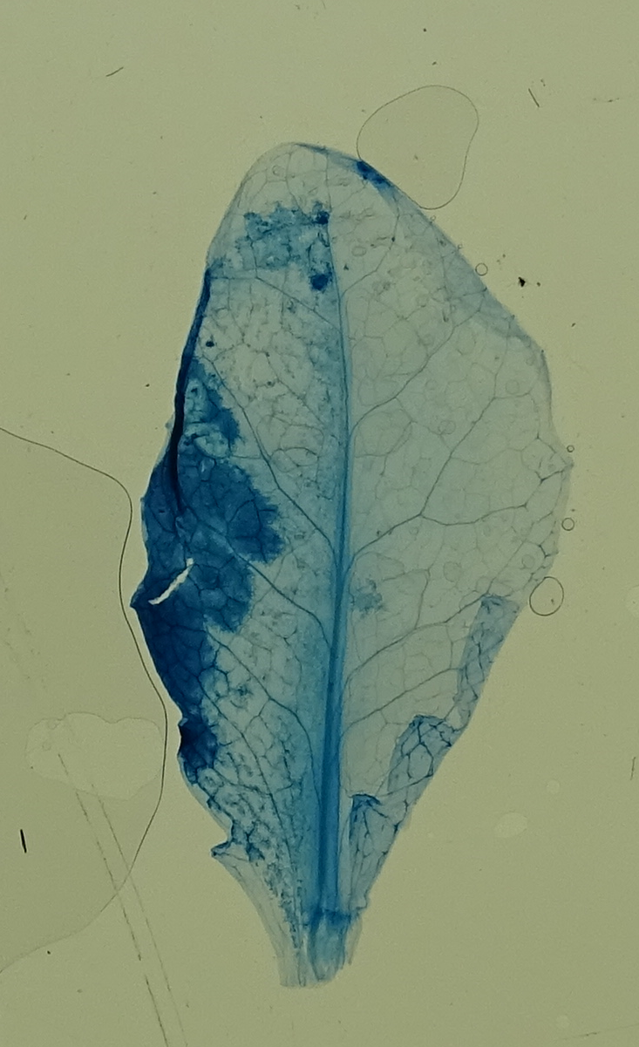
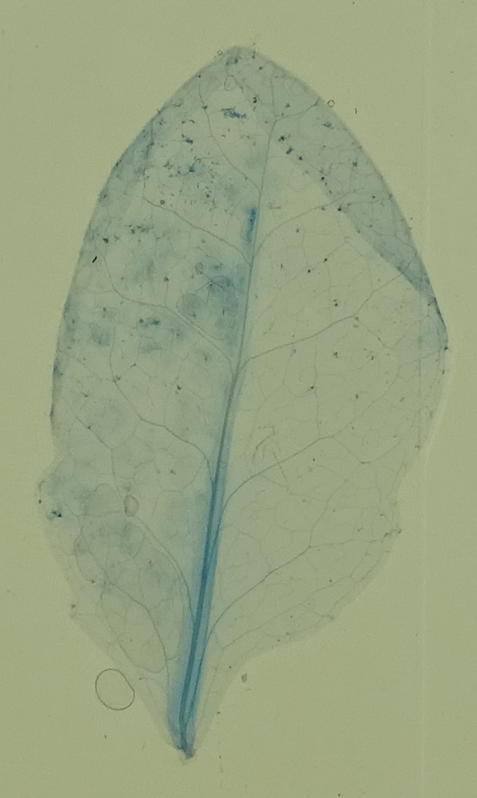
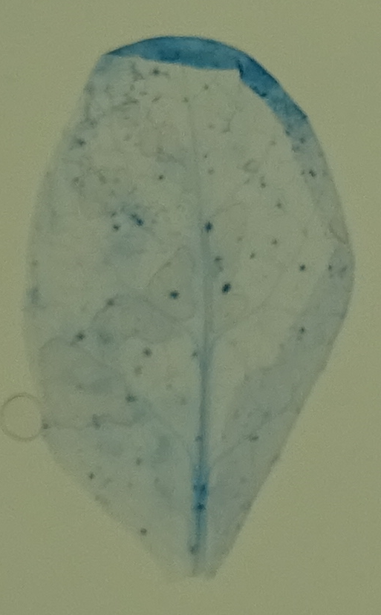
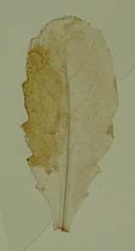
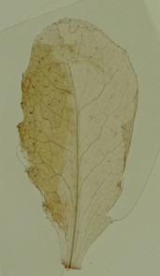
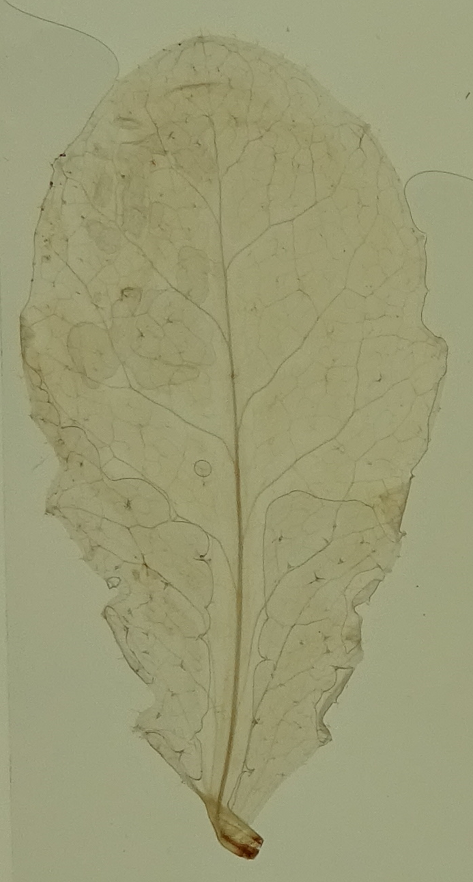
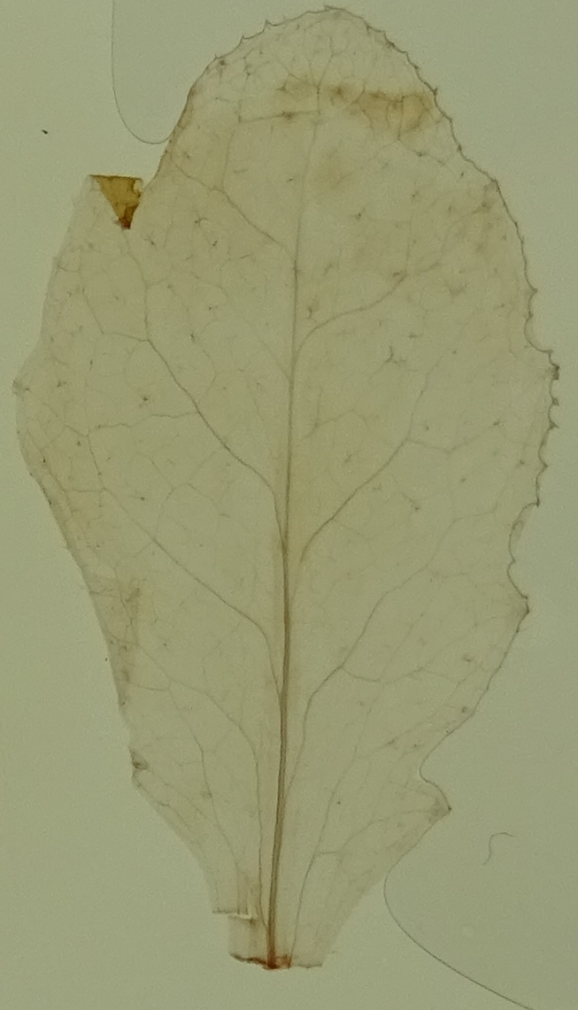
HR
No HR
Trypan blue staining
DAB staining

Slide 12
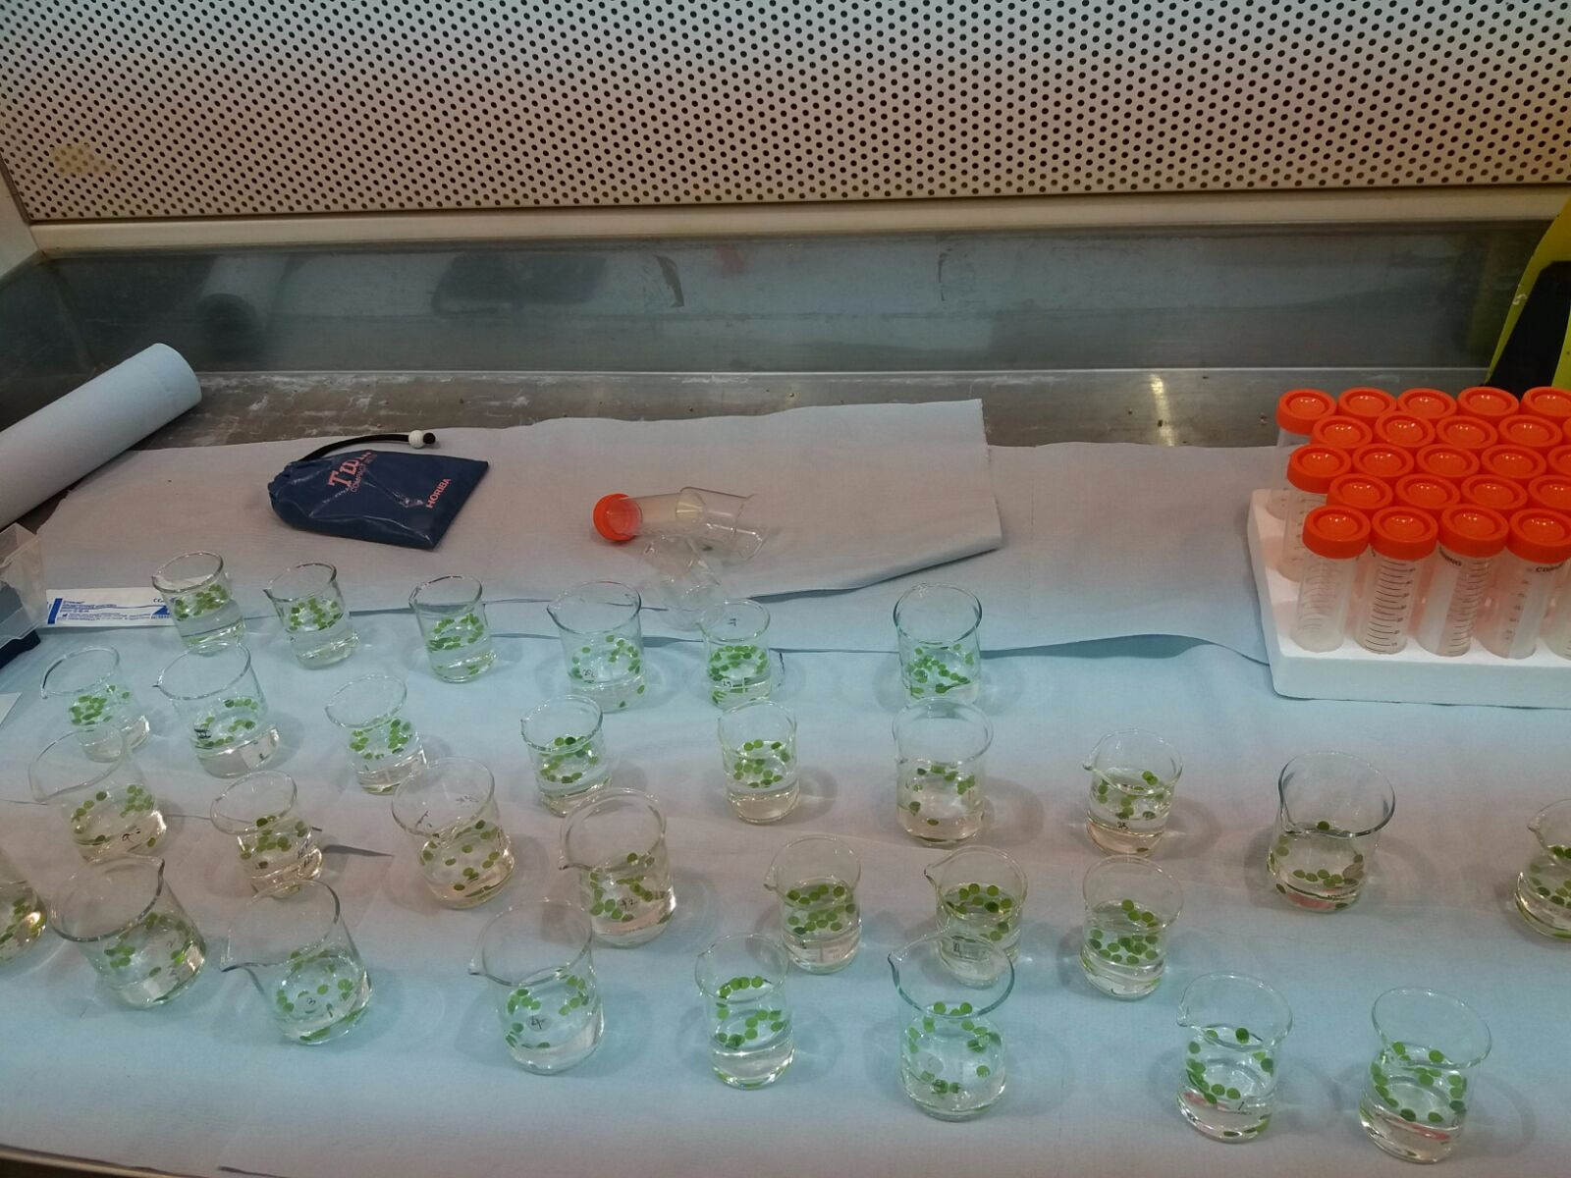

Ion leakage/ Conductivity assay

Slide 13
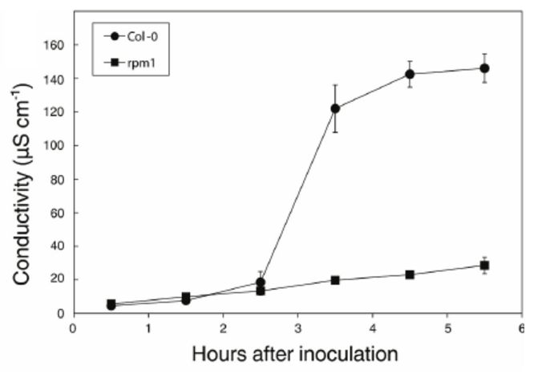
Ion leakage/ Conductivity assay

